Slide 1
Task Scheduling Algorithm Analysis
Course: CSE 4300 Section: 4
DATE
By Jan Ramirez, Nicholas Garcia, Jonathan Jawahar, Joseph Solis

Slide 2
Overview
Our project simulates task scheduling using three algorithms:
FIFO (First In, First Out)
SJF (Shortest Job First)
Round Robin (Time Quantum)
Key features include task generation, metric calculations, visualizations, and results saved to files.

Slide 3
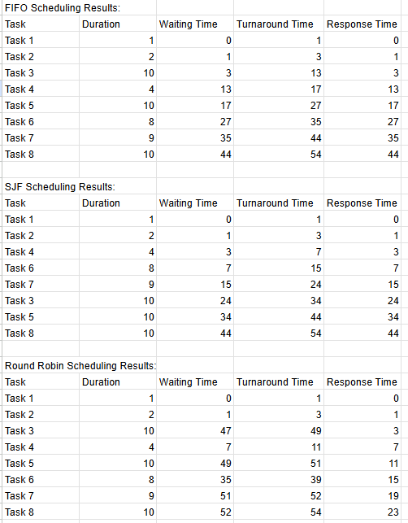
Metrics Calculated
- Waiting Time: Time spent in queue before execution.
- Turnaround Time: Total time from arrival to completion.
- Response Time: Time from arrival to first execution.

Slide 4
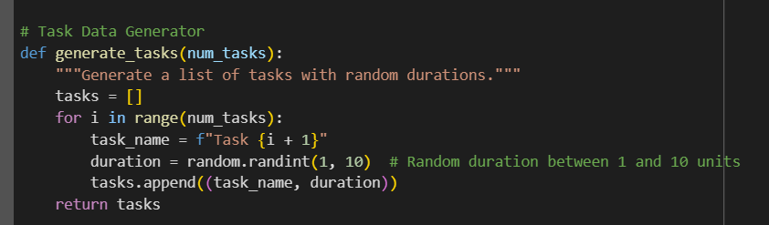
Task Generation
The tasks in our code are randomly generated with the following criteria:
Duration: 1 - 10 units
Priority: 1 (highest) to 5 (lowest)
Each task is represented as:
(Task Name, Duration, Priority)

Slide 5

FIFO
Consider the line at a food truck. Customers are served in the order in which they arrive, regardless of what they ordered or how long it takes to cook their meal.
Pros:
Easy and fair - first come, first served.
Easy to implement.
Cons:
If the first customer purchases anything sophisticated, everyone else must wait longer, even if their orders are simple.

Slide 6

SJF
Consider a café where the barista selects who to serve based on the amount of time required to prepare their order. If someone orders a quick espresso, they are served before someone purchases a complete breakfast tray.
Pros:
Reduces the overall wait time for every client.
Effective for simple jobs.
Cons:
Unfair—longer orders could make customers feel ignored, which is akin to starving.
Accurately estimating the time required for each operation is challenging.

Slide 7
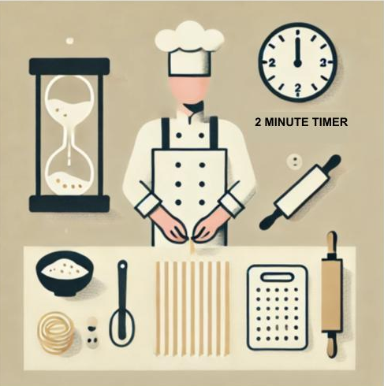
Round Robin
Finally, consider a buffet with one chef. The chef makes a small part of each person's food in turn. They start with one person's spaghetti for two minutes, then move on to the next person's burger for two minutes, and so on until all orders are finished.
Pros:
Fair — everyone gets attention at regular intervals.
Prevents any single customer from monopolizing the chef's time.
Cons:
Overhead from switching between tasks (context switching).
If time slices are too small, orders may take longer overall due to frequent switching.

Slide 8
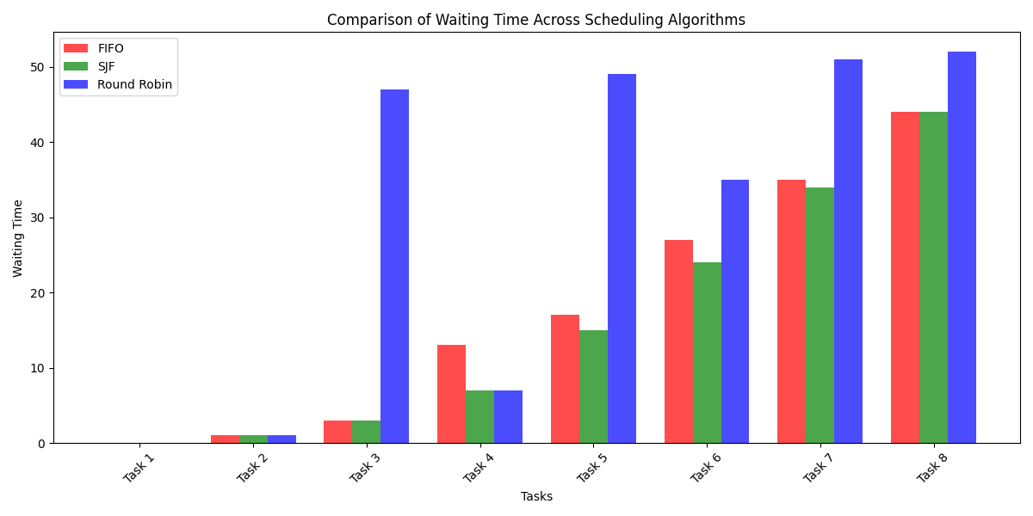
Waiting Time
FIFO: High for longer tasks and those arriving later due to waiting for all preceding tasks to finish.
SJF: Optimized overall. Short tasks finish quickly, but longer tasks may have higher turnaround times.
Round Robin: Higher than SJF for short tasks due to time slicing but distributes execution more evenly.

Slide 9
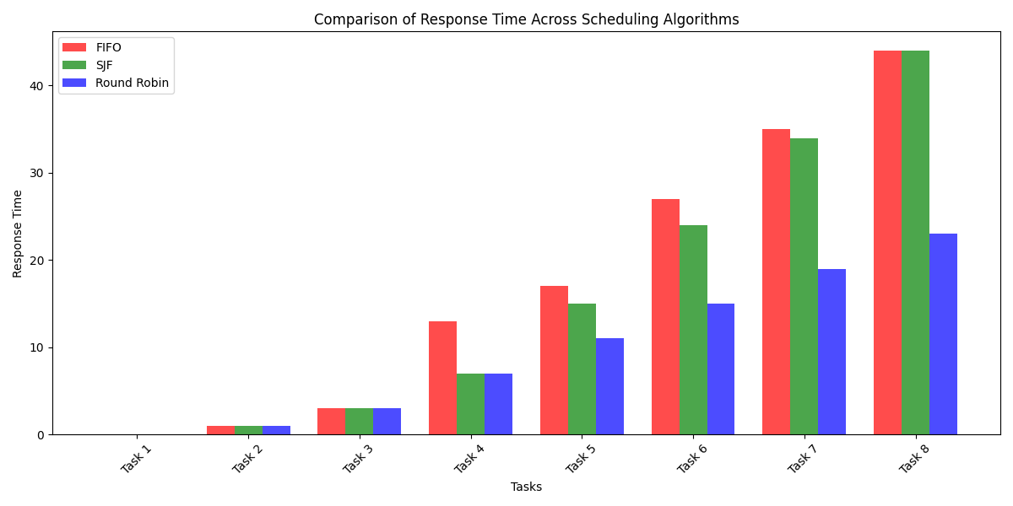
Response Time
FIFO: Increases steadily as tasks wait for earlier ones to finish. Later tasks have higher response times.
SJF: Optimized for shorter tasks. Longer tasks may experience delays due to prioritization of shorter ones.
Round Robin: Fairly distributed. Tasks get early execution opportunities, resulting in generally lower response times.

Slide 10
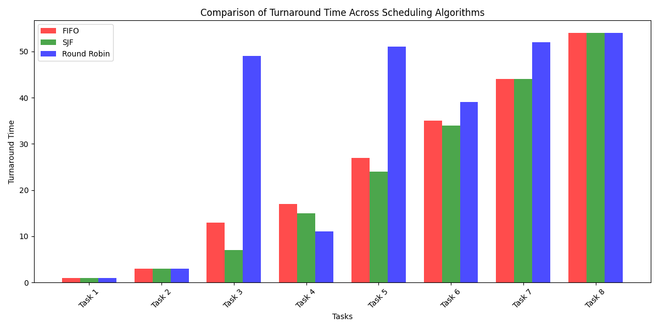
Turnaround Time
FIFO: Increases cumulatively for tasks. Later tasks face significantly higher waiting times.
SJF: Minimized for short tasks but risks starvation for long ones.
Round Robin: Balanced across tasks. Periodic execution prevents long waits or starvation.

Slide 11
Thank You

